Slide 1
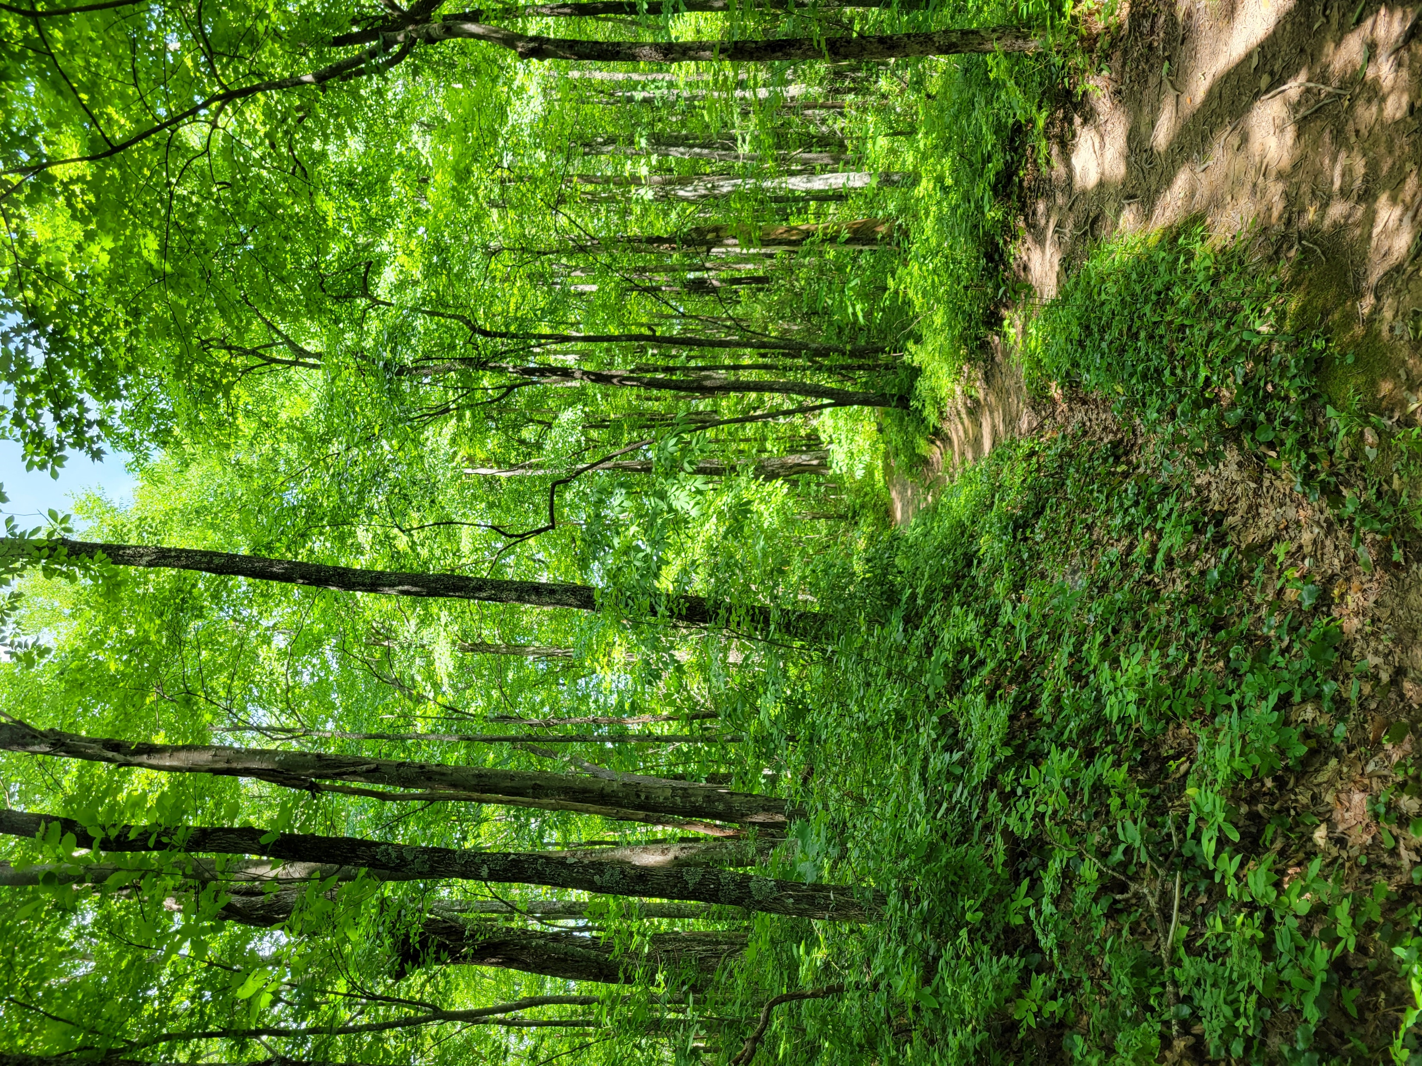





Regulation and modeling nonstructural carbohydrate dynamics
Scott W. Oswald, Doug P. Aubrey,
Dan M. Ricciuto, Jeff M. Warren
Ecological Society of America, Montréal, QC
August 18, 2022

Slide 2
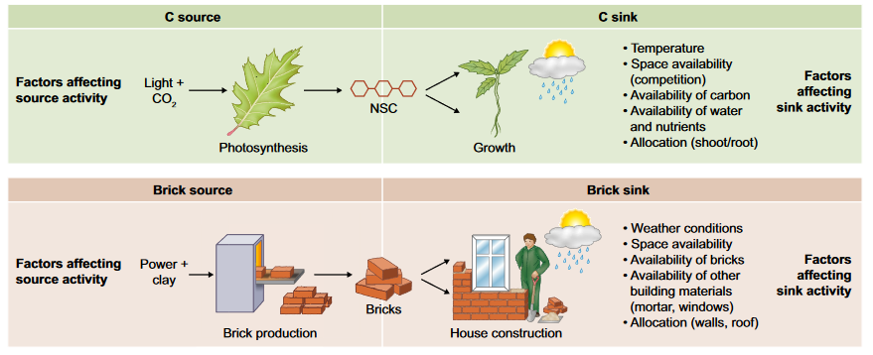
Fig 1. Fatichi et al. 2019
Respiration
Storage
Nonstructural carbohydrates = NSC = sugars + starch

Slide 3
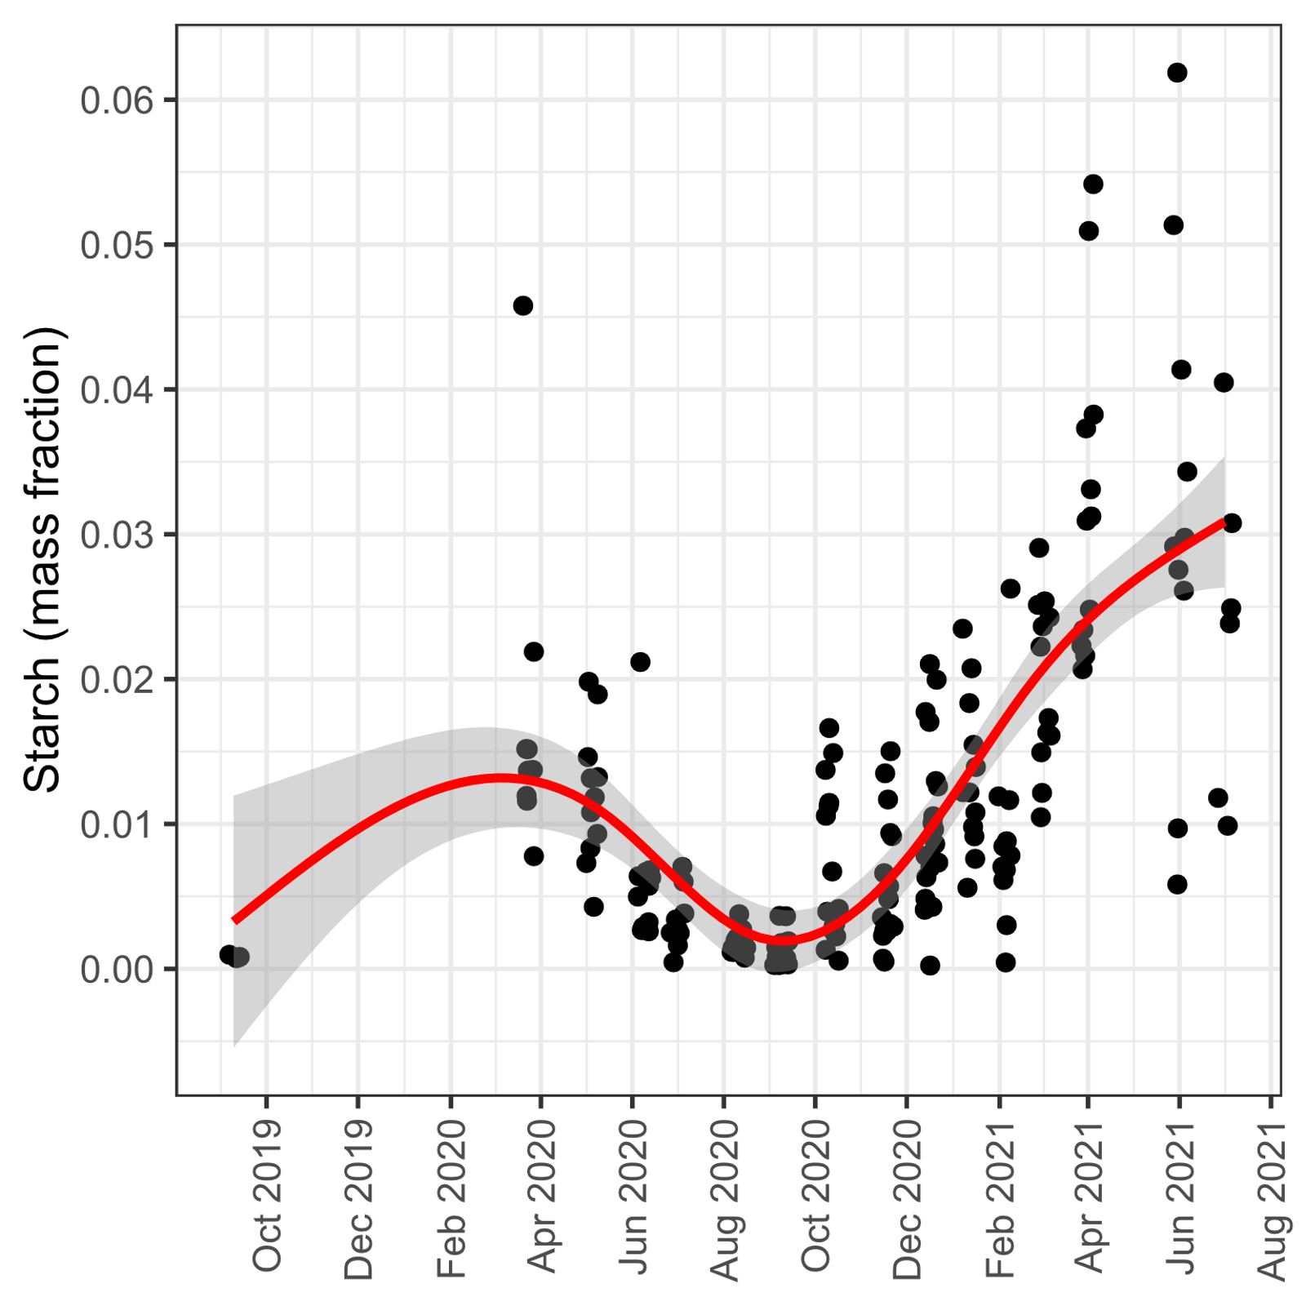
From here to there…
Loblolly Pine Saplings (Pinus taeda)
From processes to dynamics
Respiration
Storage

Slide 4
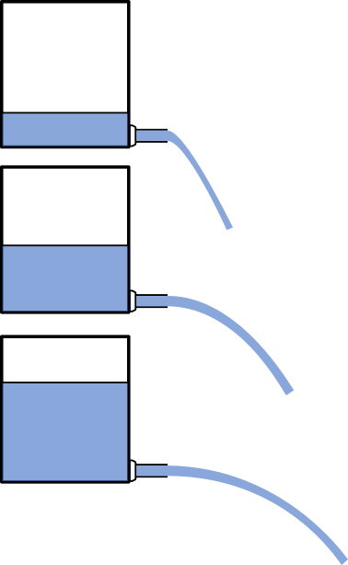
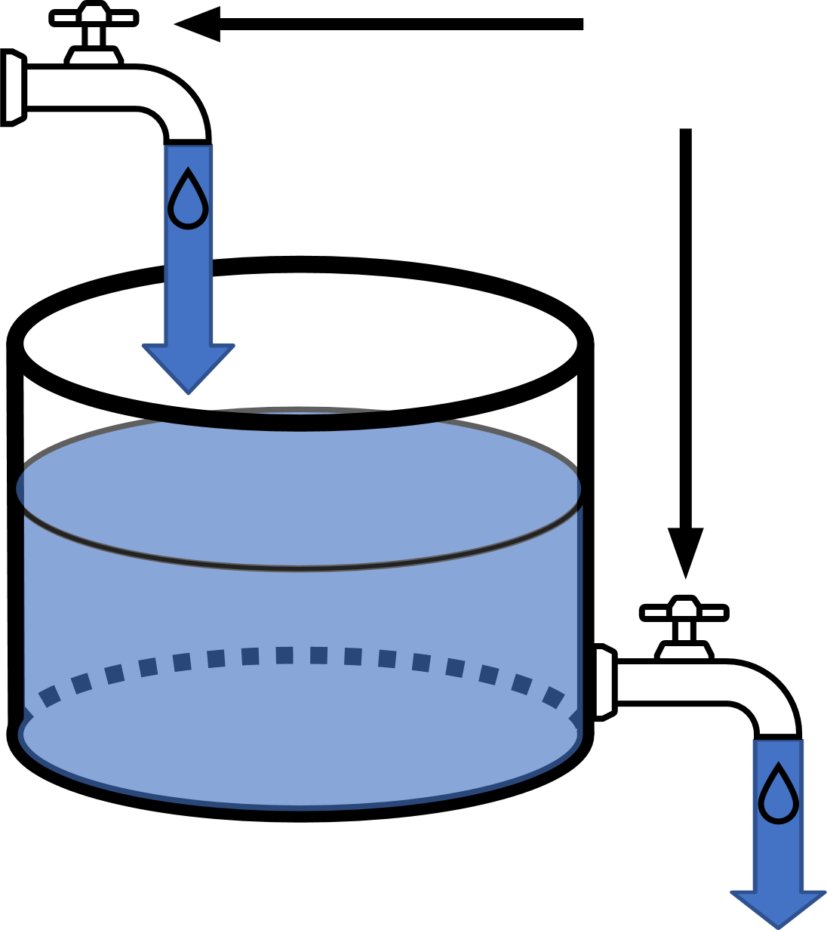
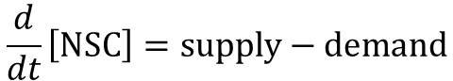
Carbon mass balance analogy
Photosynthesis = NSC supply
Environment influence
changes valves
NSC
Respiration + Growth = NSC Demand
$$\frac{d}{dt}\left[NSC\right]=supply−demand$$

Slide 5
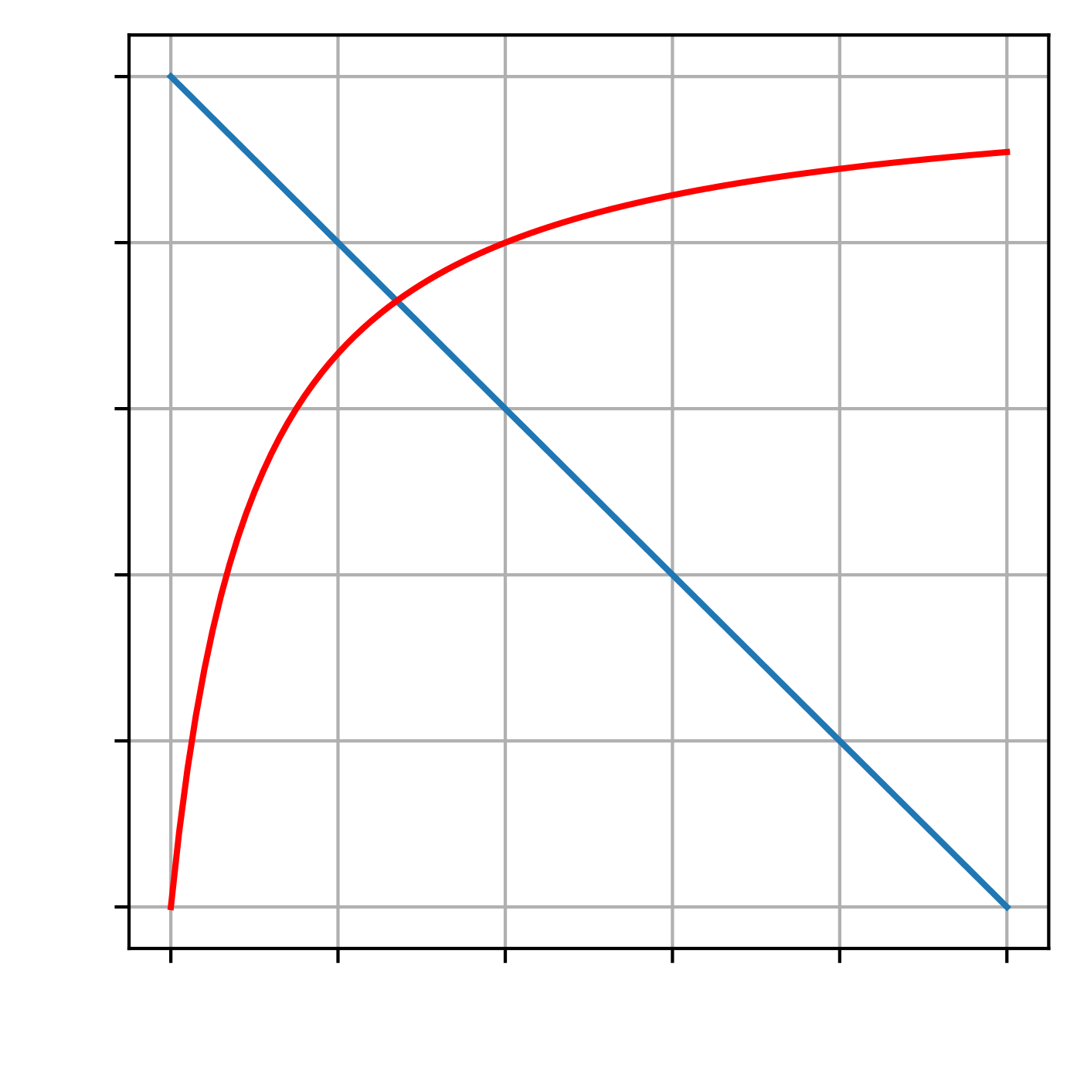
Supply and demand feedback = how inflow and outflow depends on NSC
Demand
Rate
Supply
NSC

Slide 6
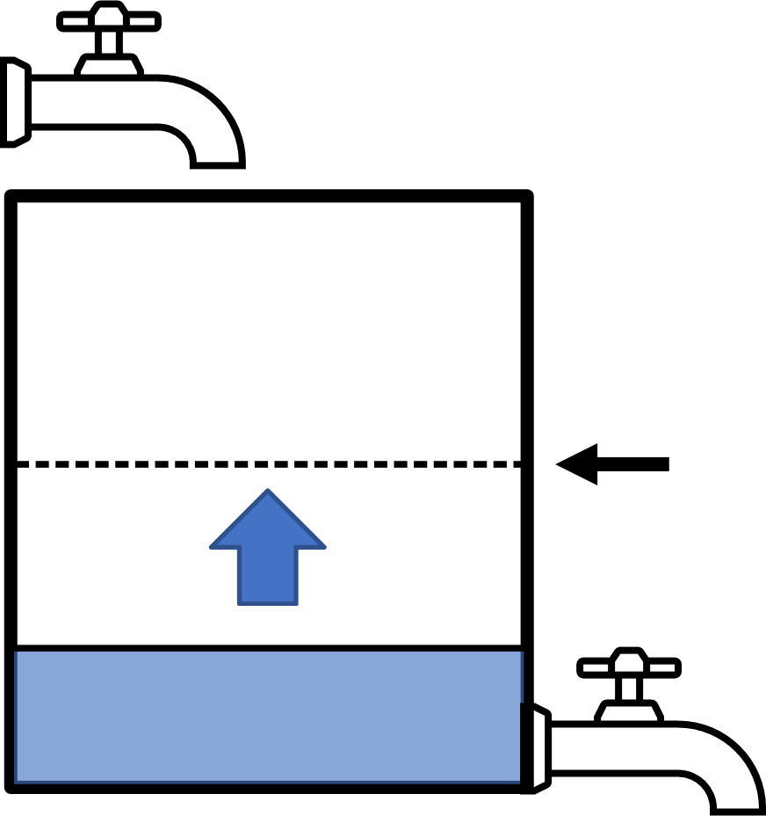
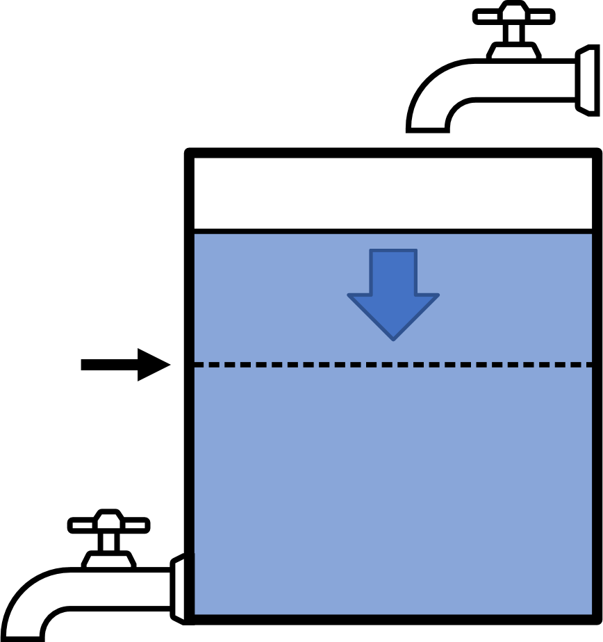
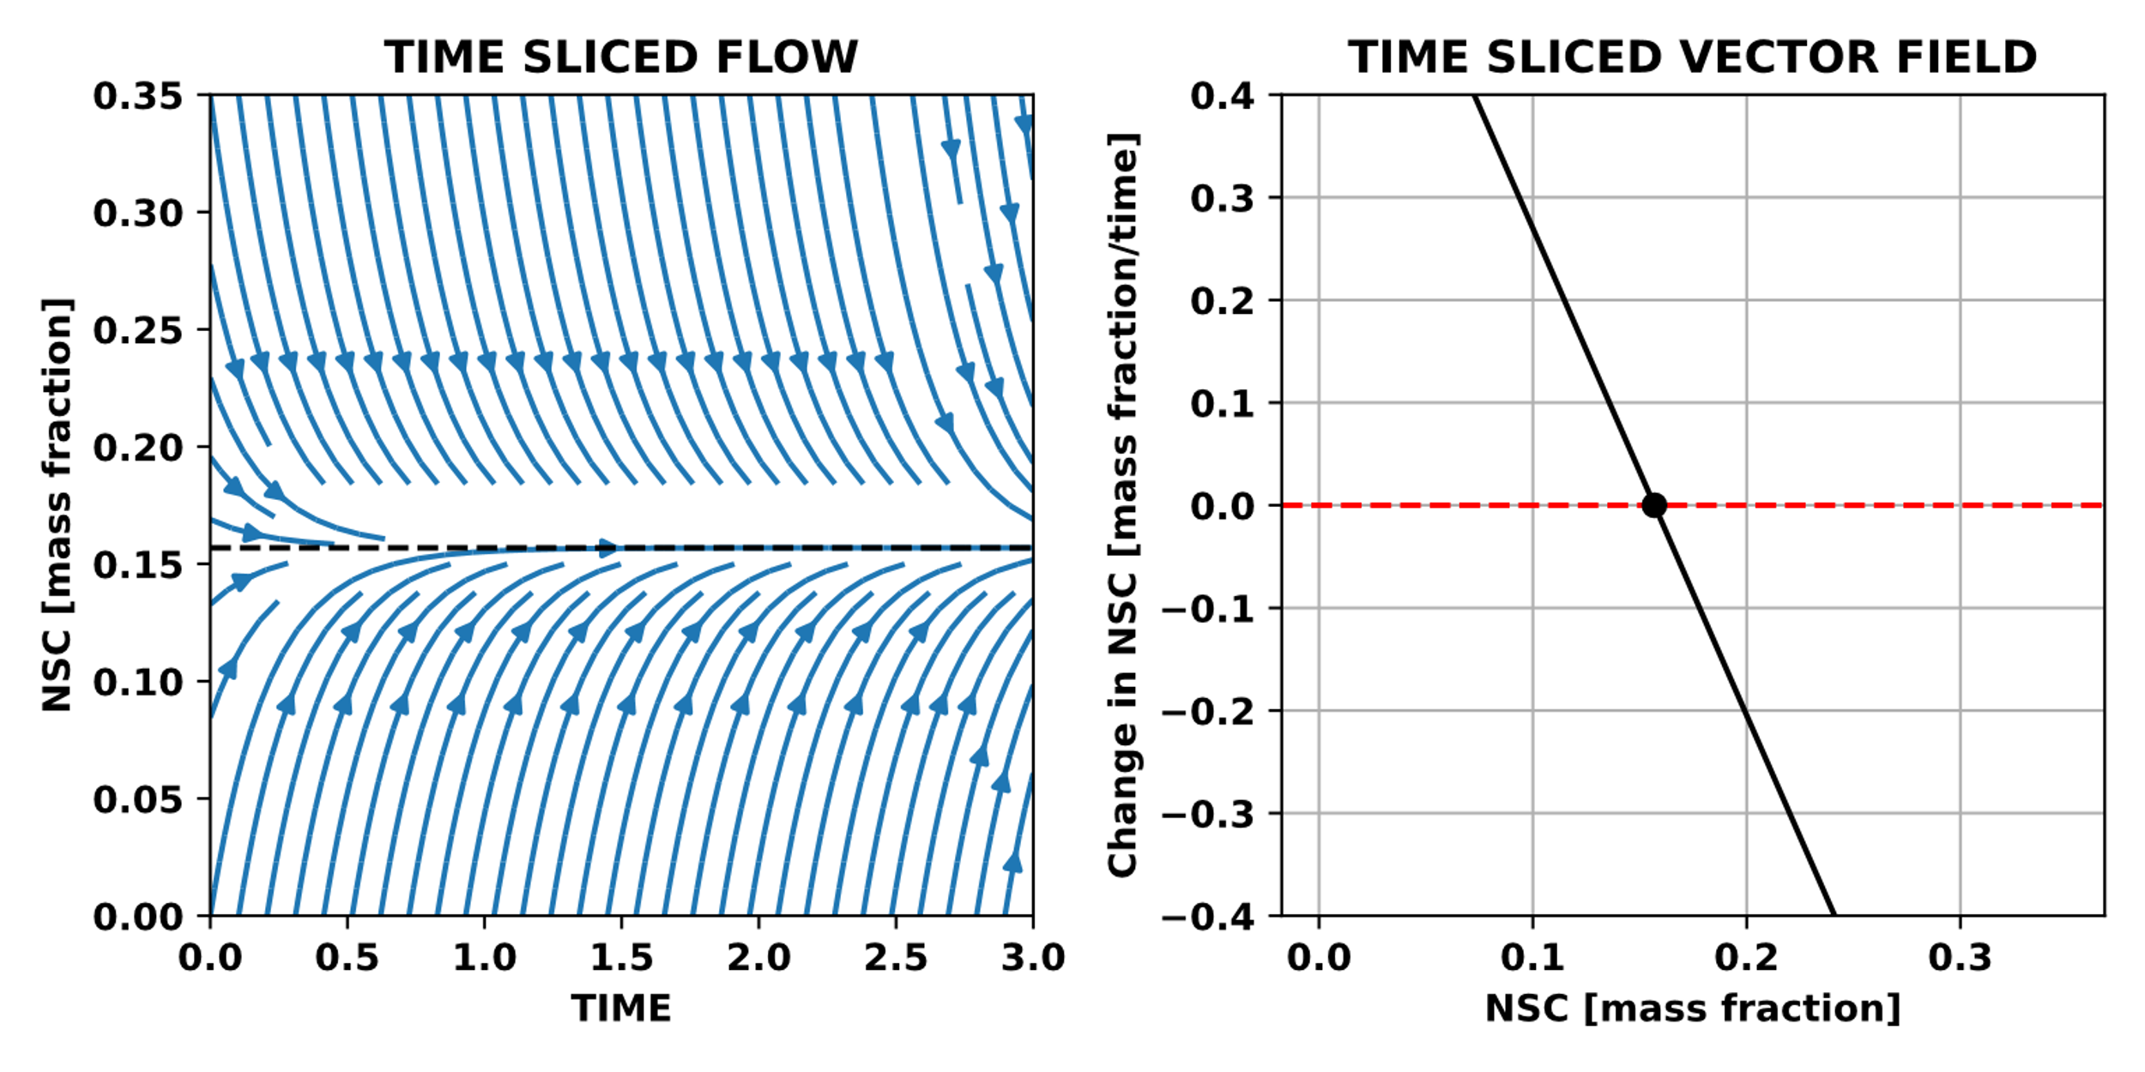
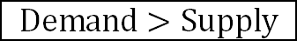

In constant environment
NSC supply and demand
feedback determines response + dynamics
Balance point
Demand
$$Demand>Supply$$
$$Demand>Supply$$
Rate
Balance point
=
Long-term NSC response
=
Attractor
Supply
NSC

Slide 7
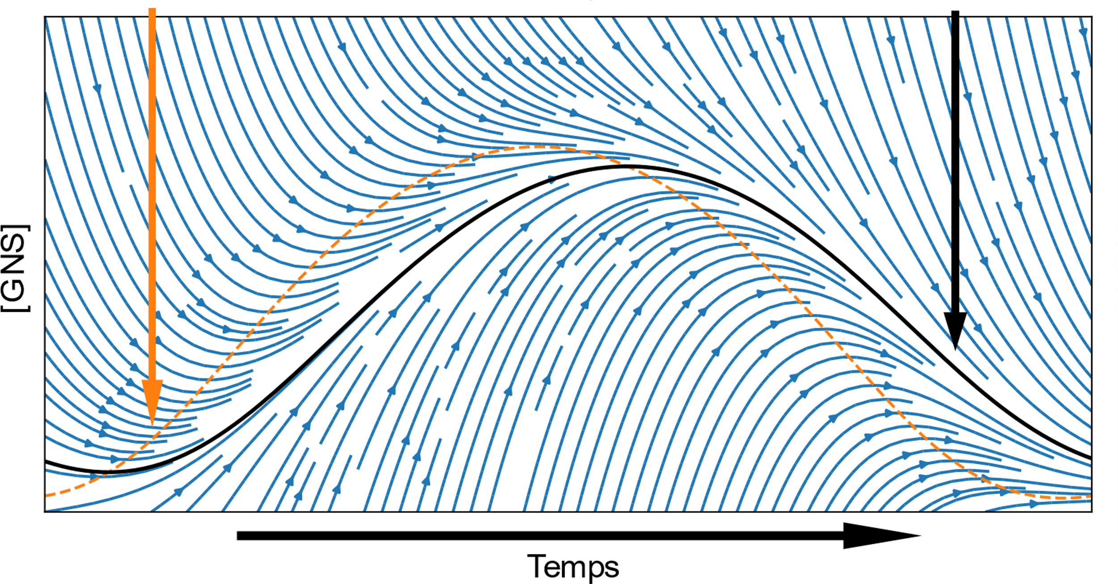
Changing environment changes
Long-term NSC response =
Balance point
Attractor
[NSC]
Time

Slide 8
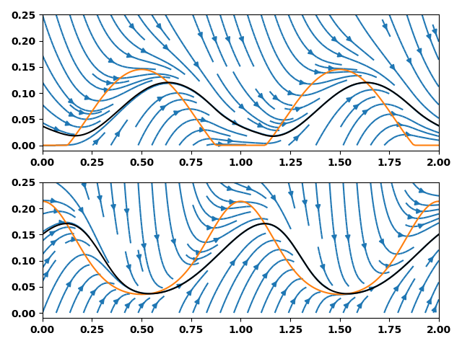
Balance point
Attractor
Environment
only affects
NSC (mass fraction)
Time (y)
Environment
only affects

Slide 9
Balance point
Attractor
Environment
only affects
NSC (mass fraction)
Environment
only affects
Time (y)

Slide 10
Mature Turkey Oak
(Quercus laevis)
Loblolly Pine Saplings (Pinus taeda)
Mature Longleaf Pine (Pinus palustris)

Slide 11
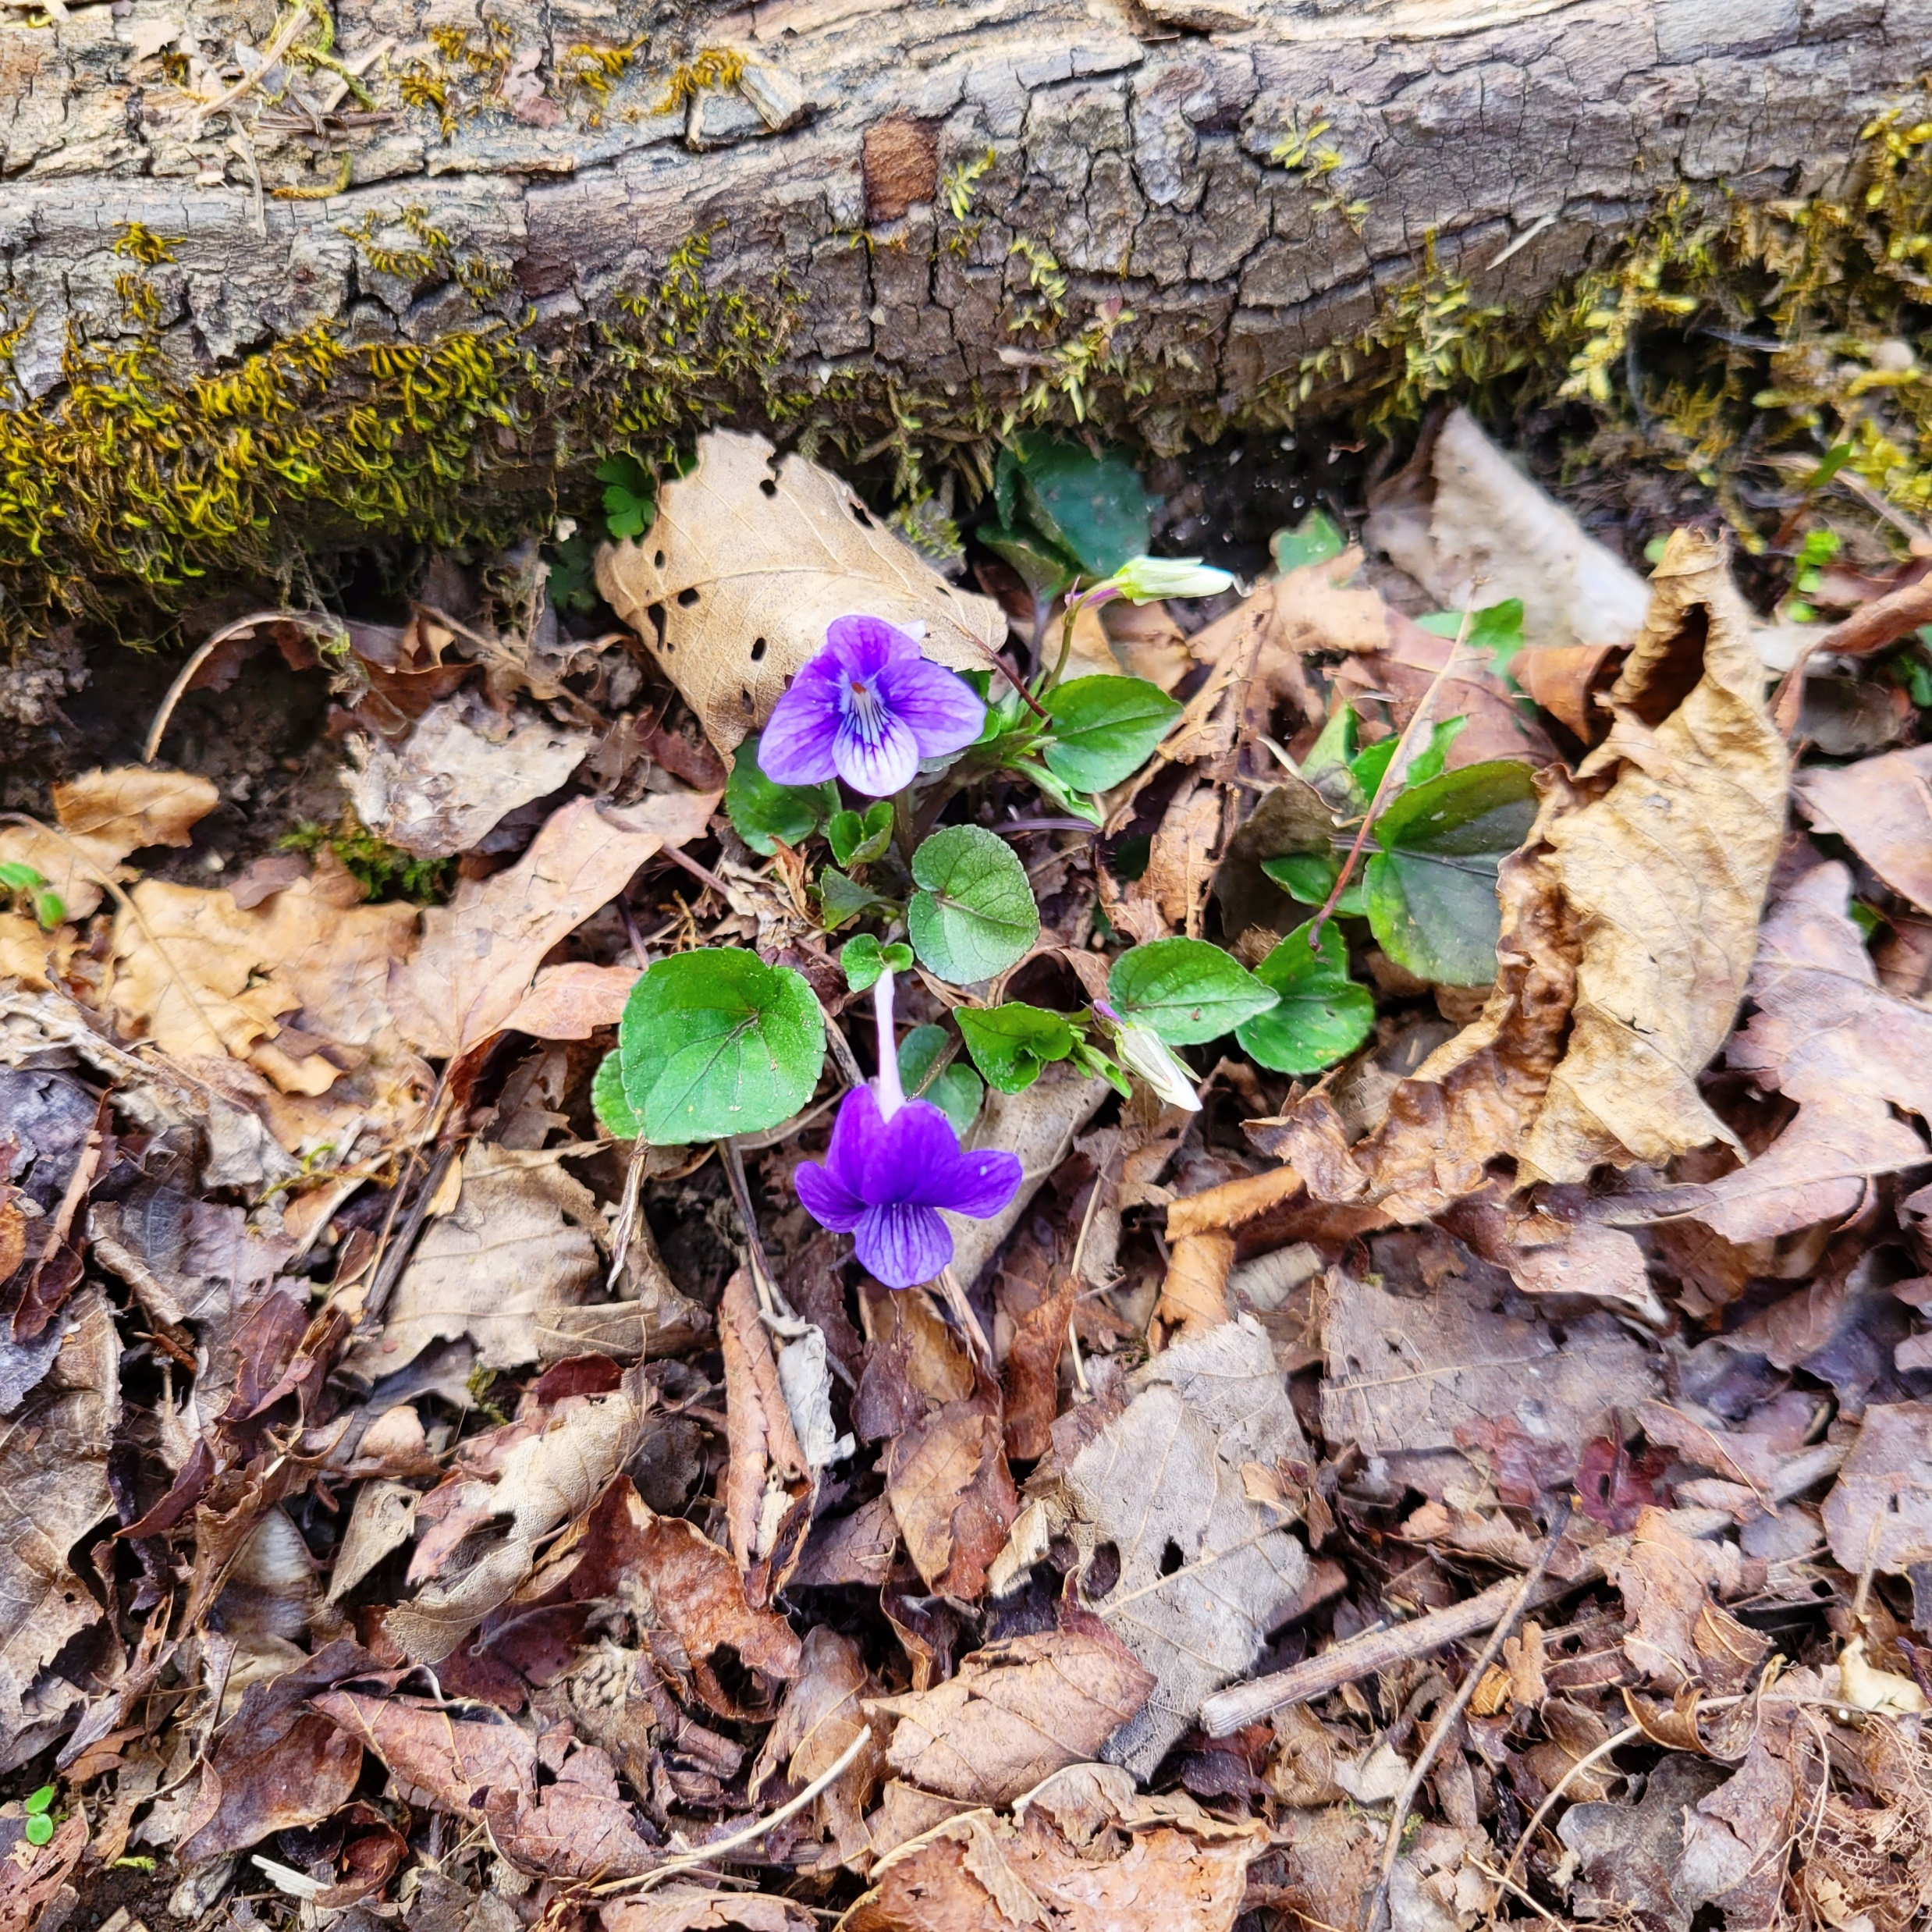
Summary
Photosynthesis = NSC supply
Adjustable
Demand
Complex dynamics possible with simple regulation
Rate
Supply
NSC
Regulation form determines balance point and attractor
NSC
Respiration + Growth = NSC Demand
Questions? Comments?
Hiring? Vous engagez?
leaves.and.lemmas@gmail.com

Slide 12
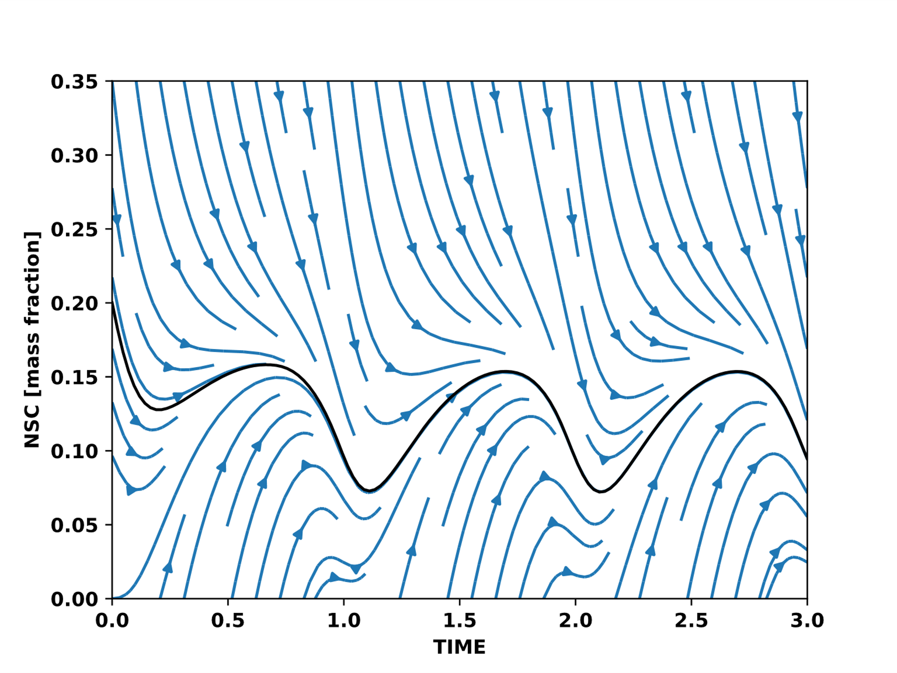
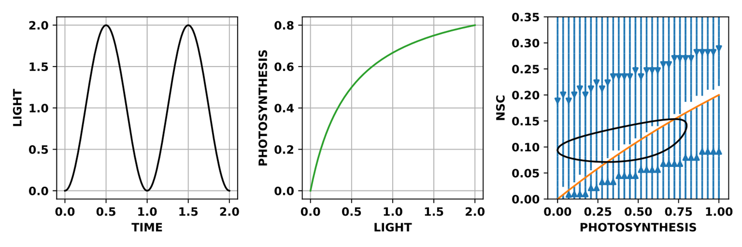
Stable for all environments

Slide 13
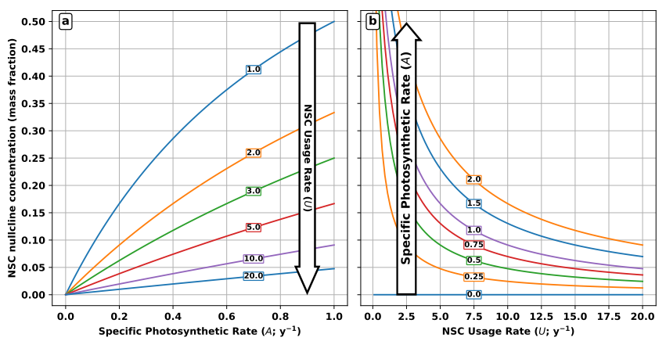
NSC balance point (mass fraction)

Slide 14
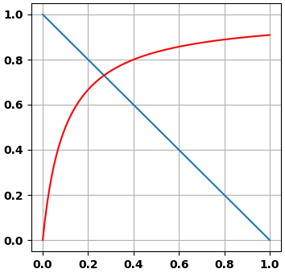
Photosynthesis
Adjustable
Rate
NSC
Respiration + Growth
NSC

Slide 15
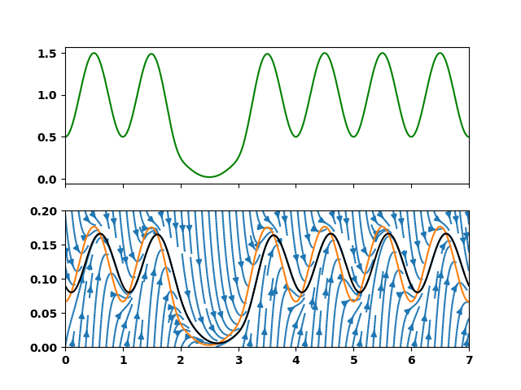
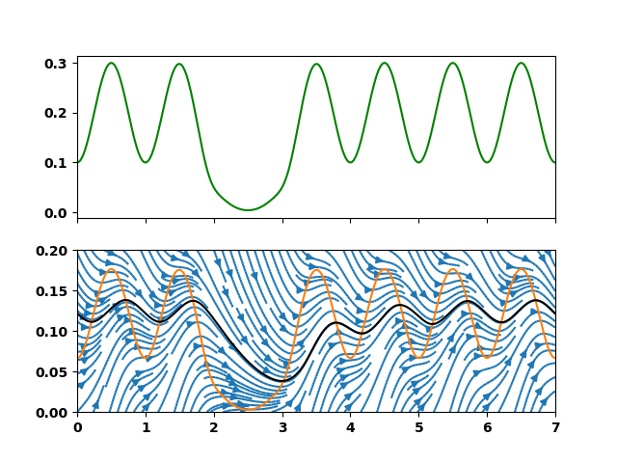
Supply rate
NSC (mass fraction)
Slower rate of supply and demand

Slide 16
NSC balance point (mass fraction)

Slide 17
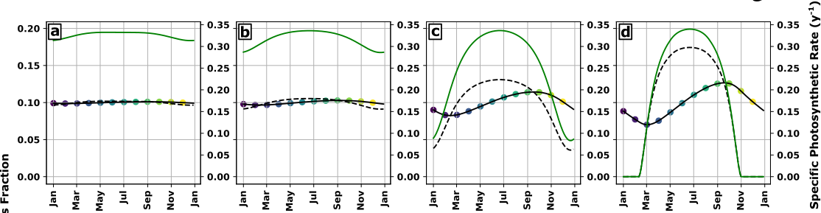
NSC (mass fraction)
Increasing seasonal amplitude of NSC supply

Slide 18
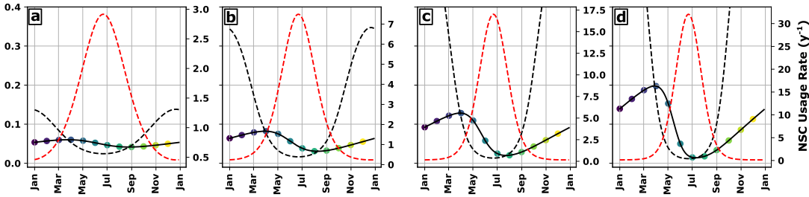
NSC (mass fraction)
Increasing seasonal amplitude of NSC demand

Slide 19
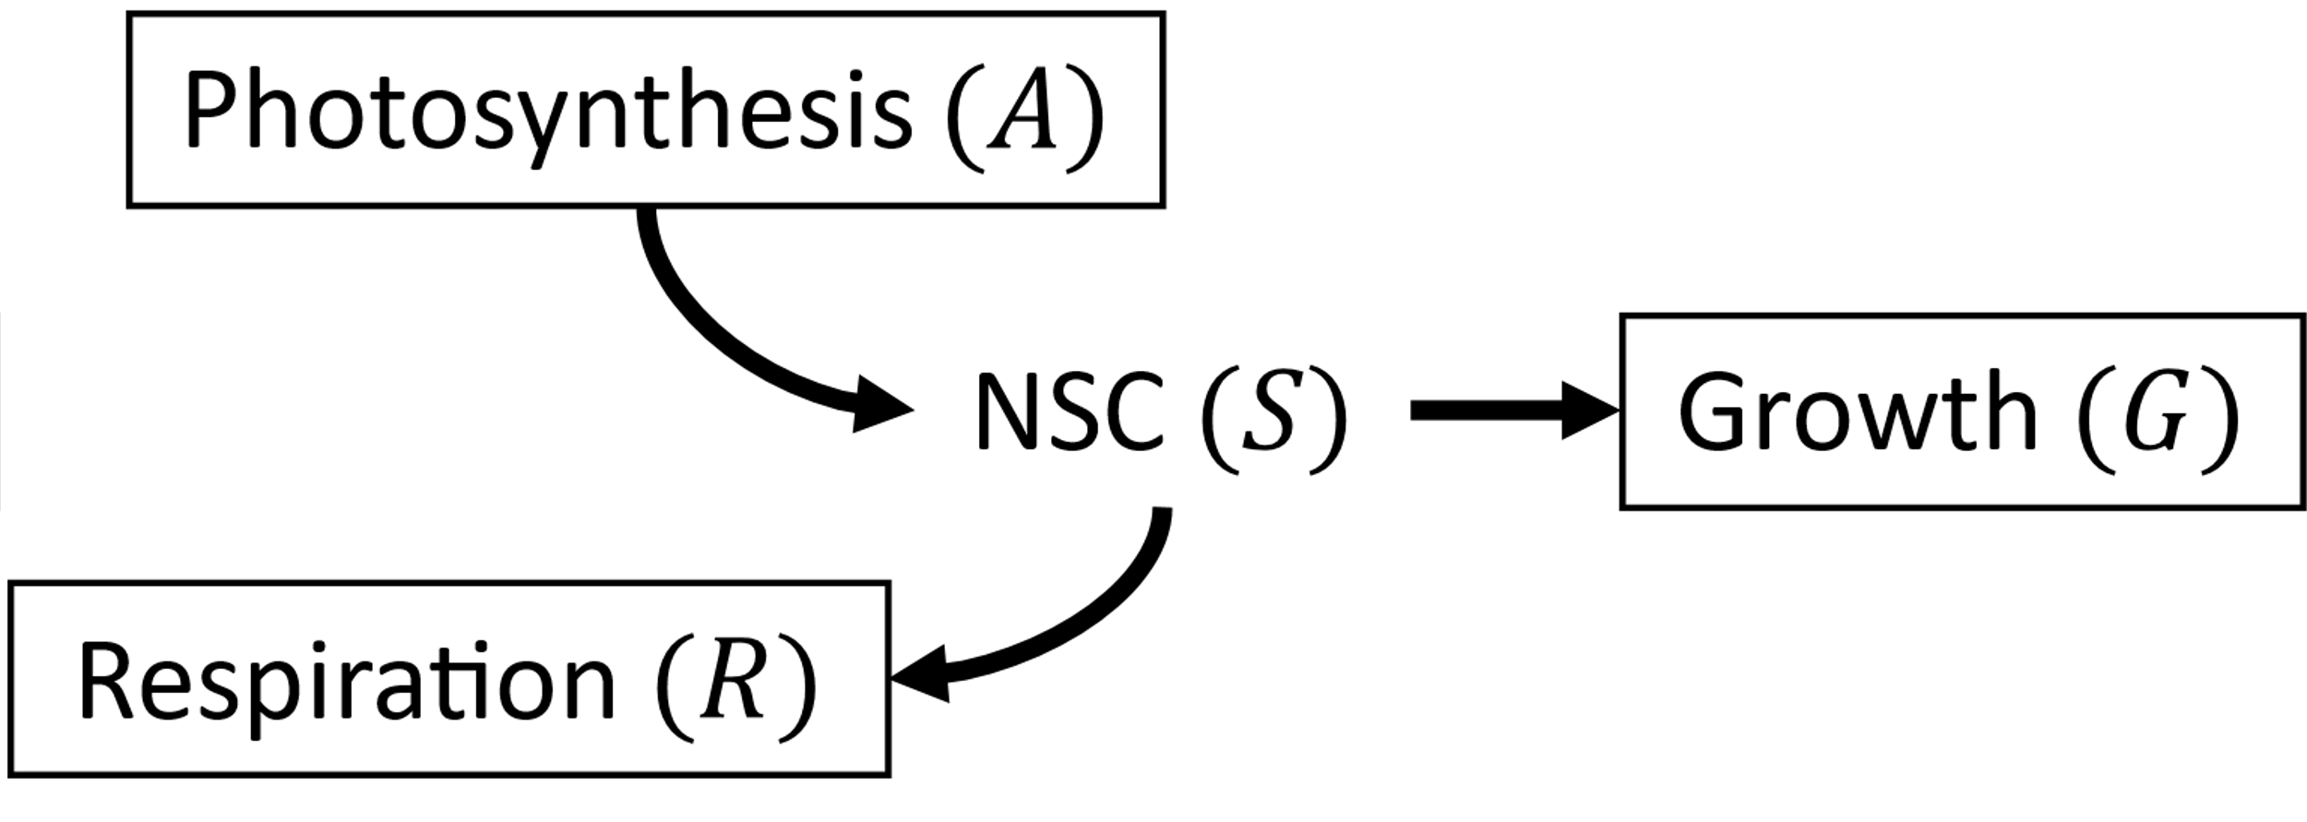
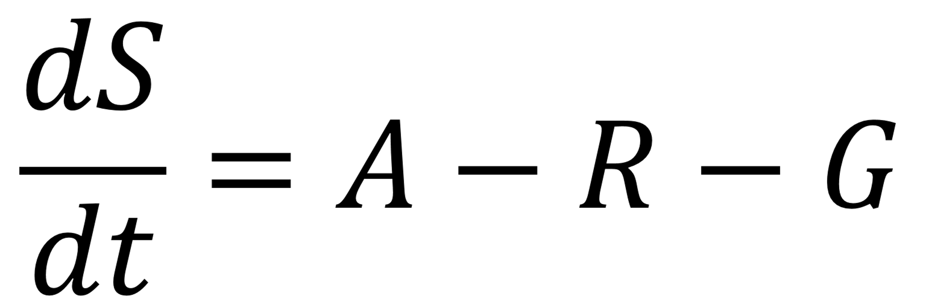
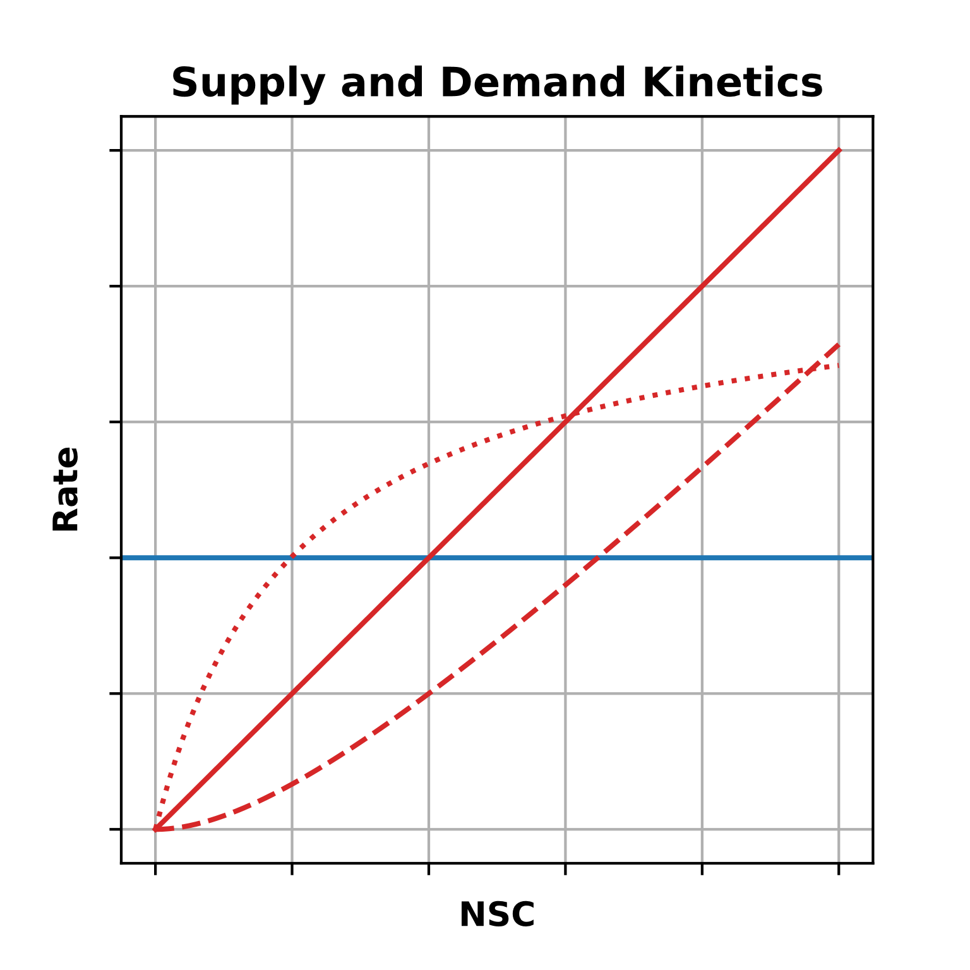

Slide 20
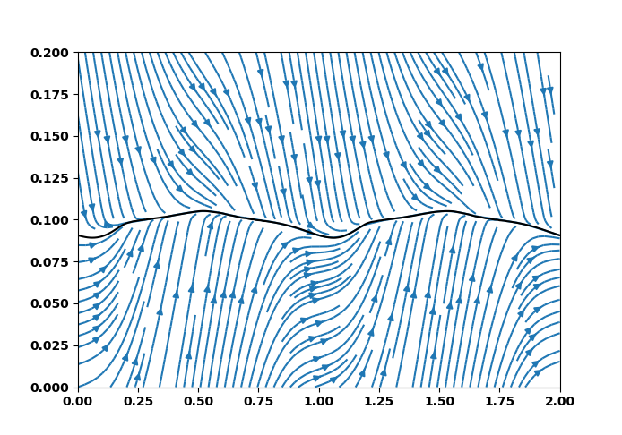
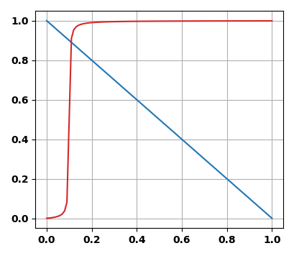
Homeostatic dynamics
Demand Rate
Supply Rate
NSC (mass fraction)
Time (y)

Slide 21
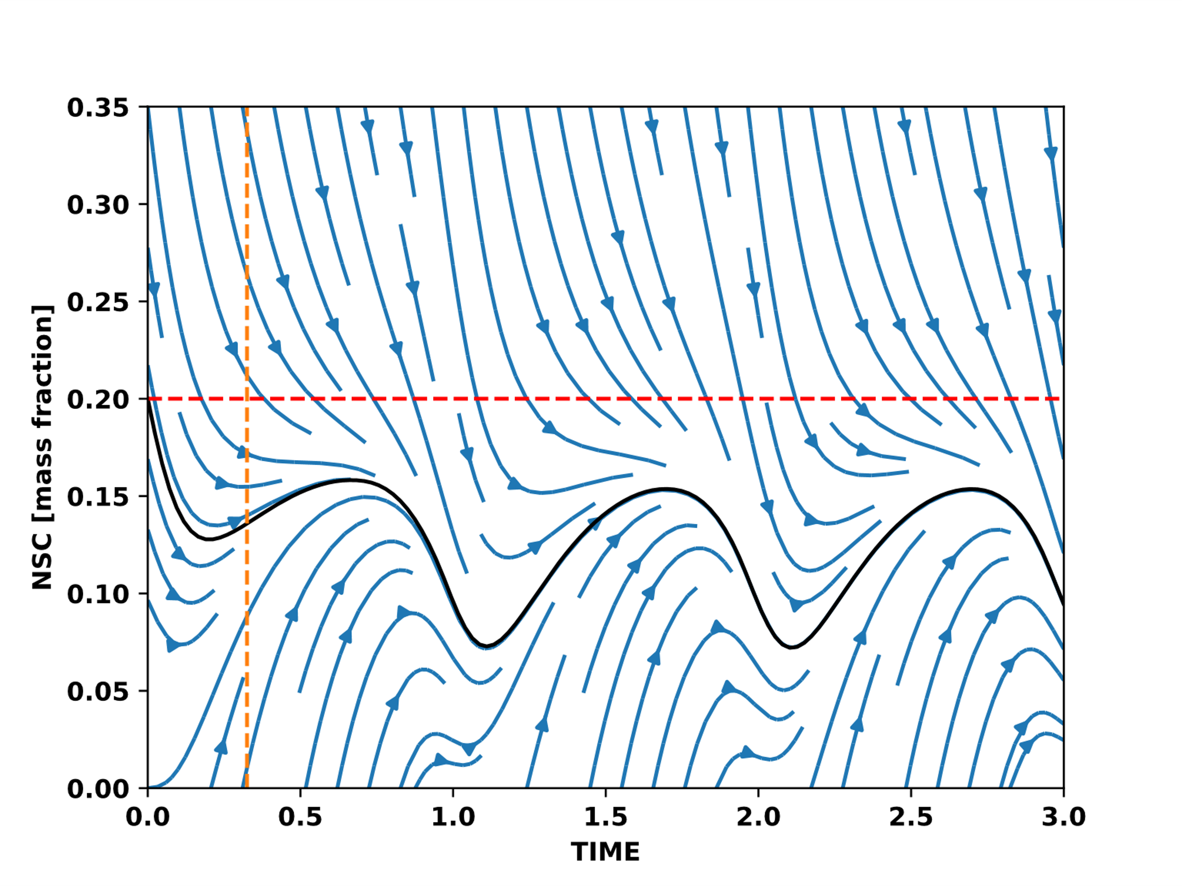
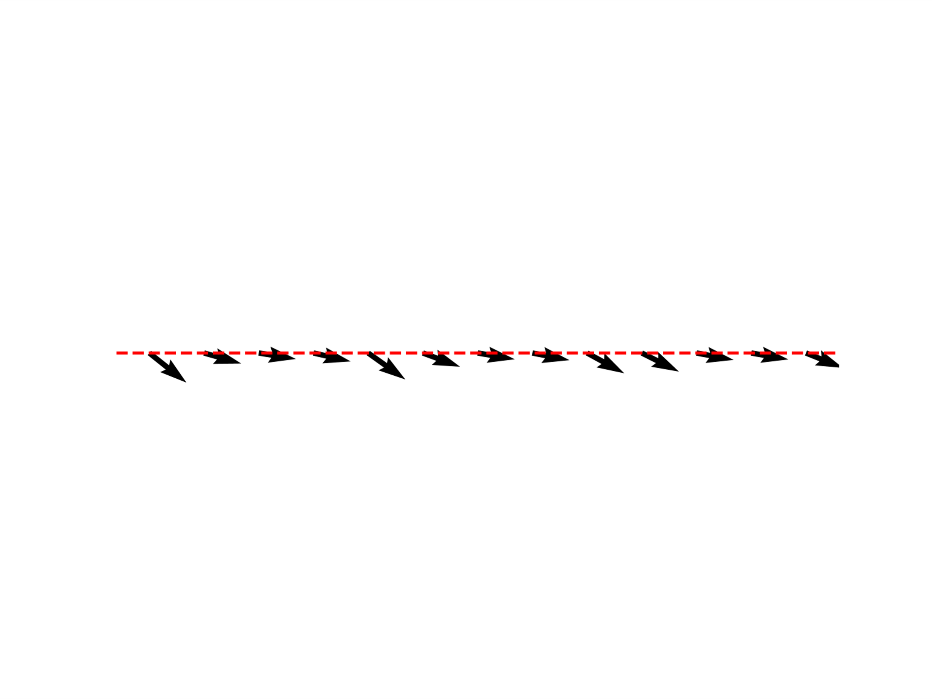
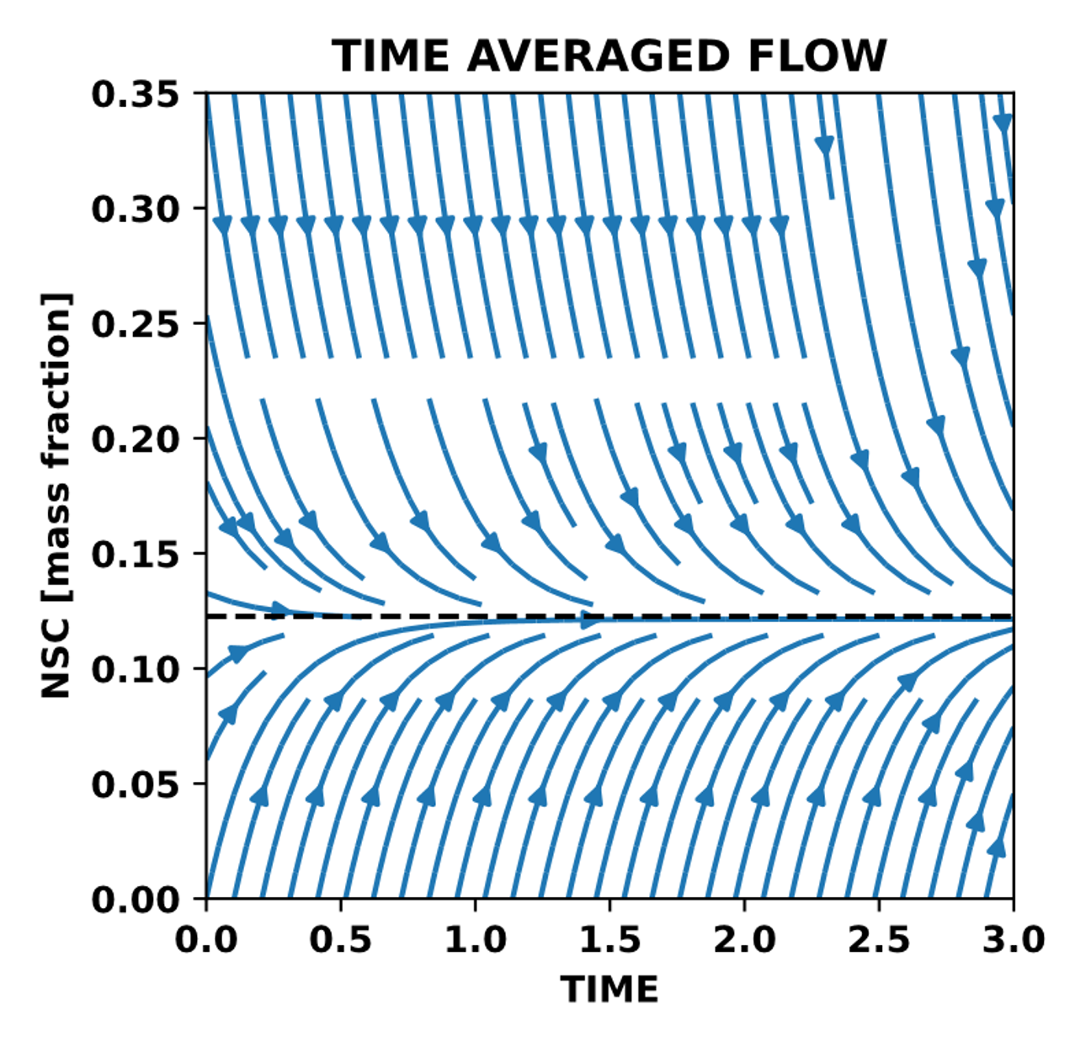

Slide 22
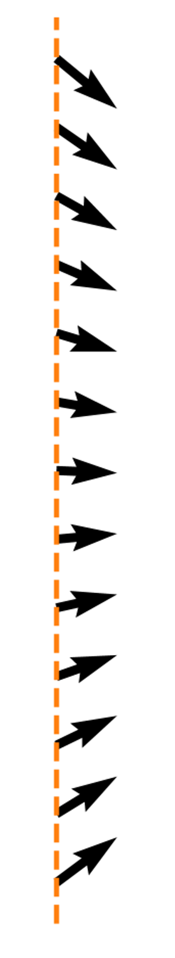

Slide 23
